Slide 1
02 Introduction to Relational Databases & DBMS
Core Concepts

Slide 2
Recap
Database – a collection of data that is logically coherent.
DBMS – Database Management System
defines, creates, and maintains a database.
Allows users controlled access to data in the database.
Relational Database – data is organized into 2 dimensional tables

Slide 3
Relational model
Tables are the external view
The data are represented as a set of relations.
A relation is a two-dimensional table.
This doesn’t mean that data are stored as tables; the physical storage of the data is independent of the way the data are logically organized.

Slide 4
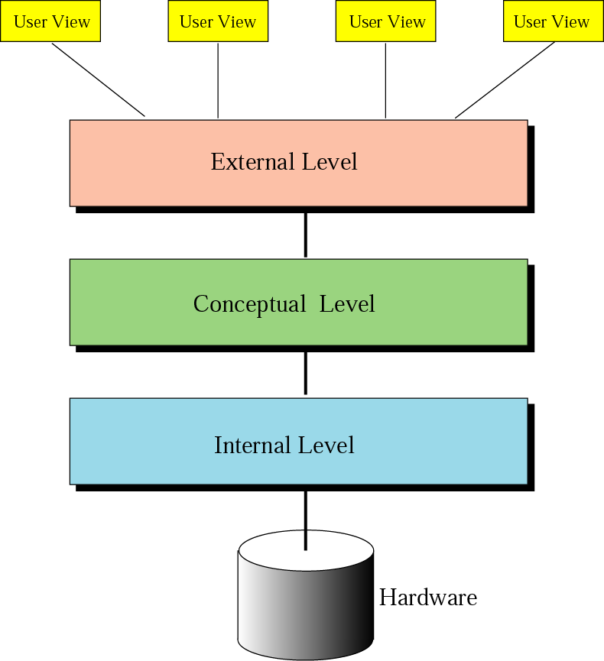
DBMS
architecture
Figure 14-2

Slide 5
Architecture
Internal level –
Determines where data are actually stored on the storage device.
Low-level access method
Conceptual level –
Defines the logical view of the data
The main functions of DBMS are in this level.
External level –
Interacts directly with the user.
Change the data coming from the conceptual level to a format and view that are familiar to the users.

Slide 6
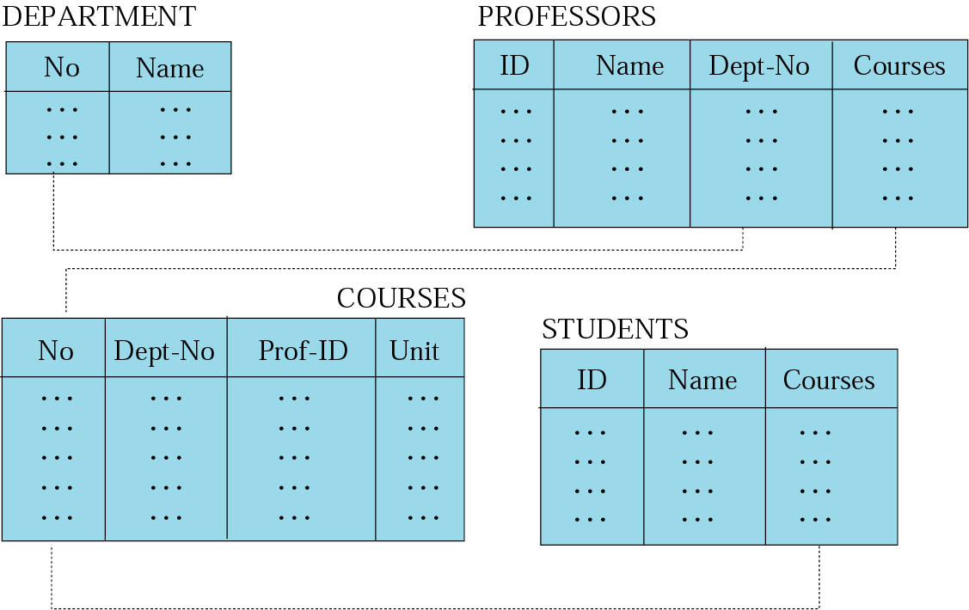
Figure 14-5
Relational model
Data are organized in two-dimensional tables called relations.
The tables are related to each other.
The most popular model.

Slide 7
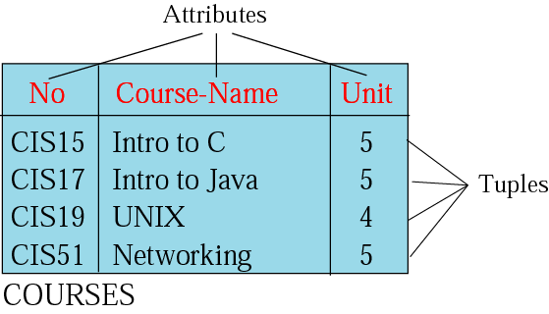
Relation
Name – each relation in a relational database should have a name that is unique among other relations.
Attribute – each column in a relation.
The degree of the relation – the total number of attributes for a relation.
Tuple – each row in a relation.
The cardinality of the relation – the total number of rows in a relation.

Slide 8
Relational Database
Definition:
Data stored in tables that are associated by shared attributes (keys).
Any data element (or entity) can be found in the database through the name of the table, the attribute name, and the value of the primary key.

Slide 9
The Relational Model
Each attribute has a unique name within an entity
All entries in the column are examples of it
Each row is unique
Ordering of rows and columns is unimportant
Each position (tuple) is limited to a single entry.

Slide 10
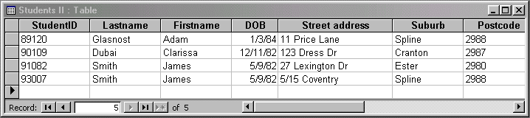
Database Table Example
Student
Primary Key Column

Slide 11
Database Table Keys
Definition:
A key of a relation is a subset of attributes with the following attributes:
Unique identification
Non-redundancy

Slide 12
Types of Keys
PRIMARY KEY
Serves as the row level addressing mechanism in the relational database model.
It can be formed through the combination of several items.
FOREIGN KEY
A column or set of columns within a table that are required to match those of a primary key of a second table.
These keys are used to form a RELATIONAL JOIN - thereby connecting row to row across the individual tables.

Slide 13
Relationships and Keys
Parcel
Parcel No | Assessed Value | Customer No
887419 | 152,000 | 237982455
446397 | 100,000 | 234725902
Primary Key Columns
Foreign Key Column
Customer
Customer No | Name | Address
234725902 | John Smith | 18 Lawyers Drive
098724729 | T. Brown | 14 Summers Road

Slide 14
Next up – Designing a Relational Database (1)
Getting started – Entities, attributes and Primary Keys

